Slide 1
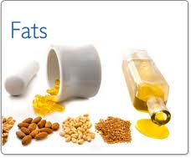
Lipids/Fats
Chapter 16

Slide 2
What are Lipids?
What are Lipids and Triglycerides? (1:54)
http://www.youtube.com/watch?v=JsMDthjr8Lo
Lipids are a family of chemical compounds that are a main component in every living cell. They include the following three categories:
  Triglycerides – they include all fats and oils people typically eat.
  Sterols – include bile, certain hormones and the most commonly known sterol cholesterol.

Slide 3
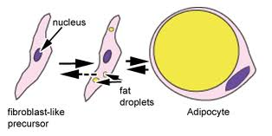
Triglycerides
What are Triglycerides? (Part 1 of 2) | HealthiNation (3:23)
http://www.youtube.com/watch?v=E-u5j_Us8uI
Absorbs vitamins A,D,E,&K and transports them to our organs
Keeps skin, hair & nails looking healthy
Cushions vital organs and bones
Serves as energy for the body when needed
Stored in adipose tissue, pockets of fat stored in a thin layer under your skin

Slide 4
Structure of Triglycerides
Composed of carbon, hydrogen and oxygen.
Fatty Acids are organic acids found in triglycerides
Our body makes all but two fatty acids which are linoleic and linolenic both are needed for normal growth and development.
Linoleic and linolenic can be obtained from vegetables, grains, nuts, seeds and soybeans

Slide 5
Saturated and Unsaturated Fat
How to Understand the Difference between Saturated and Unsaturated Fats (2:10)
http://www.youtube.com/watch?v=crYNIlcUOiE
Coconut Oil: The one saturated fat you should be eating (4:05)
http://www.youtube.com/watch?v=S5kKlR5Mqgo
Saturated
Unsaturated

Slide 6
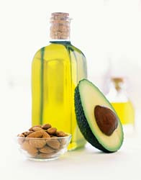
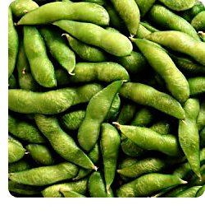
Good Fats
What Are Unsaturated Fats? (2:11)
http://www.youtube.com/watch?v=XjZ60fcIPBg
Monounsaturated
Polyunsaturated
Omega 3 fatty acids

Slide 7
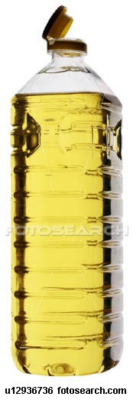
Monounsaturated
Polyunsaturated
Olive oil
Canola oil
Peanut oil
Sunflower oil
Sesame oil
Avocados
Peanut Butter
Nuts
Soybean oil
Corn oil
Safflower oil

Slide 8
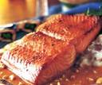
Omega-3 Fatty Acids
Omega 3's Help You Burn Fat (3:37)
http://www.youtube.com/watch?v=9Tcnn7Yyp6k
Fish – albacore tuna, salmon
Soybeans
Walnuts
Flaxseeds

Slide 9
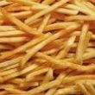

Bad Fats
Saturated
Trans-fatty acids

Slide 10
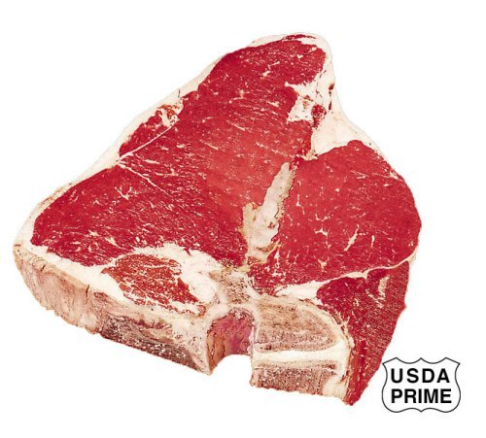
Saturated
Fat found in animal products and coconut oil
Beef
Lamb
Pork
Butter
Cheese
Cream
All Whole milk dairy products

Slide 11
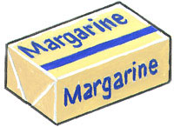
Trans Fat & Hydrogenated Fats
The Truth About Hydrogenated Oils & Trans Fats
http://www.youtube.com/watch?v=ymoABAVm3Rc
Created when processed to extend the shelf life
Stick margarine
Vegetable shortening
Commercially fried foods
Packaged baked goods

Slide 12
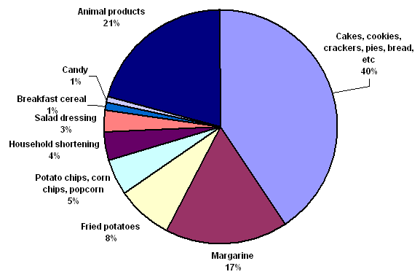
Trans Fat foods

Slide 13
Cholesterol
Understanding Cholesterol (Cholesterol #1) (2:45)
http://www.youtube.com/watch?v=wnK1Kv3XkZI
What-Is-Cholesterol.mov (2:25)
http://www.youtube.com/watch?v=tR4QrtN0r7c
A fat-like material that can be good or bad for us depending on what we eat.
Two Types
HDL – Healthy Fats, fats that come from plants
LDL – Lousy Fats, fats that come from animals

Slide 14
Recommended Daily Amount (RDA)
Limit fat intake to 30% of daily caloric intake
  Only 10% of those fats should be saturated
    Example: in a day with 2000 calories consumed, only 65 grams of fat should be eaten, with 20 grams or less of saturated fat
      Will depend on caloric intake each day

Slide 15
Fat Deficiencies
Deprived of vital nutrients
  Nutrient imbalances which can lead to ill health
  Digestion and absorption of vitamins and nutrients, such as calcium, will be affected

Slide 16
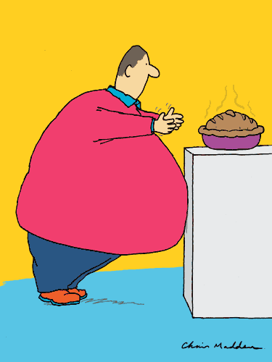
Fat Excess
Too Much Fat can lead to:
  Heart disease/attacks
  Obesity
  Diabetes
  Immune dysfunction
  Cancer
  Poor cholesterol

Slide 17
Fat Facts
Fat that is solid at room temperature is bad for you.
Fat that is liquid at room temperature is good for you.

